Slide 1
Documenting and Testing REST APIs with Swagger

Slide 2
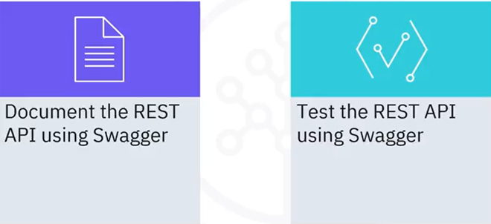
What you will learn

Slide 3

Why Swagger?
• APIs: Communication Channel
• API documentation: Reference manual
Swagger:
• Runs OpenAPI specification
• Describes the structure of API
• Builds UI
• Adheres to specifications
O Swagger
Supported by SMARTBEAR

Slide 4

OpenAPI specification
•A standard, language-agnostic
interface to RESTful APIs
•Supported operations
•API parameter inputs and outputs
•Authentication requirements
•Terms of service
•Contacts
•License information for API

Slide 5
Flask: RESTPlus
•Python functions as APIs
•Describes and visualizes REST APIs

Slide 6
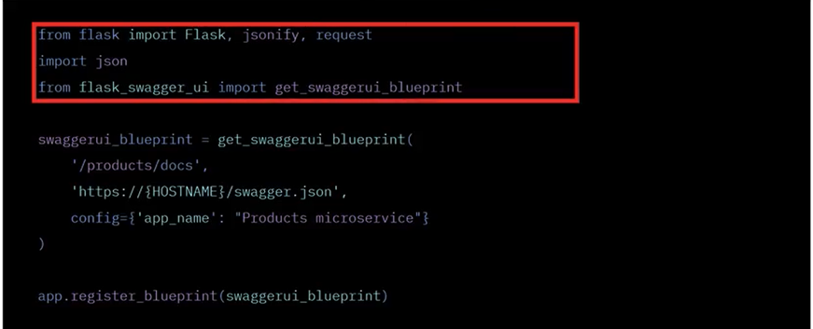
Implement Swagger

Slide 7
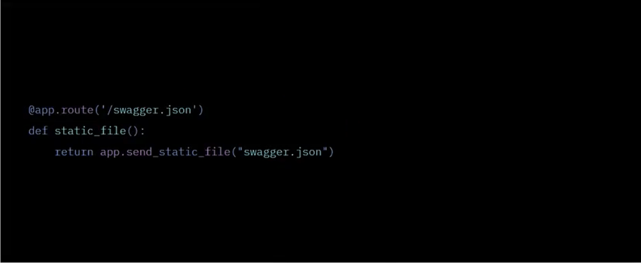
Host Swagger.json

Slide 8
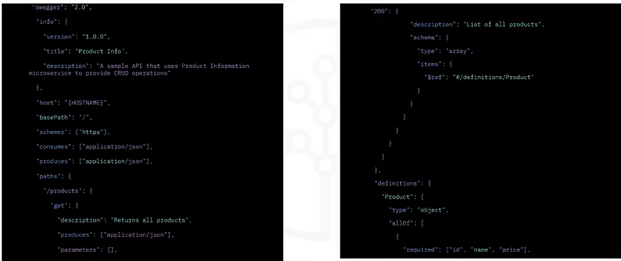
Create static swagger.json 1/2

Slide 9
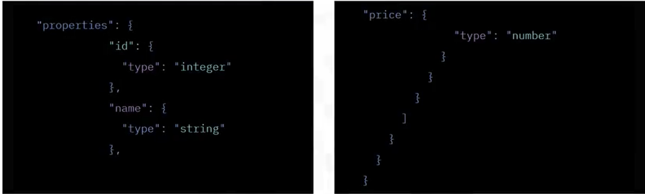
Create static swagger.json

Slide 10
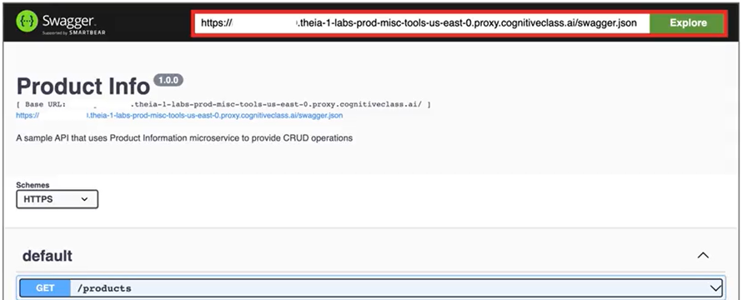
Test API using swagger 1/2

Slide 11
Recap
• Swagger helps you document your APIs
• OpenAPI specification is a standard way of representing your
APIs
• Swagger provides an API testing mechanism

